Slide 1

School of Computing Science and Engineering Greater Noida, Uttar Pradesh Fall 2022 – 2023
Semester-08 Btech CSE
Internship: TEKsystems Global Services Pvt Ltd.

Slide 2
Student Profile:
Name: Harshit Mishra
Admission Number: (19SCSE1010099)
Section: 12
Email: harshitmishra116@gmail.com

Slide 3

Abstract
Internship includes various events such as educational workshops, webinars, SimpliLearn courses, and group work assignments .At internship at TekSystem, we are divided into certain domains each domain has specific amount of training period varying from 12 weeks to 16 weeks. Full Stack Prep-up program engages young talents with a comprehensive learning pathway, giving these millennials an opportunity to become a Full Stack Engineer, understand the corporate environment andgroom themselves even before they join us. TekSystems emphasizes on Learner Autonomy where students take charge of their own learning pathway, with the available tools and resources. More focus is given to “learning” than “teaching”.

Slide 4
Internship Description
TEKsystems accelerate business transformation by solving complex technology, business and talent challenges—across the globe. TEKsystems partner with 80% of the Fortune 500 to create solutions that enable them to capitalize on change. TEKsystems is an Allegis Group company
This program is divided into Six phases, each phase carries individual technology learning ,some of those are react js, basic java , spring boot, servlets , jsp , Devops etc.
Today’s world is highly reliable on data and their appropriate management through widely used apps and software. The backbone for appropriate management of data is Data Structure and Algorithms .It is a dream for many to achieve expertise in handling and creating these apps and software. The very first step in the journey is the creation of a complete roadmap to learn data structure and algorithms

Slide 5
Internship Description
In the internship, it followed a simple pattern of learning and then testing. Therefore we first had to understand theory then solve some assignment, for knowledge validation.
At the end of the internship phase we have to fo through the capstone project , by which they will evaluate us.

Slide 6
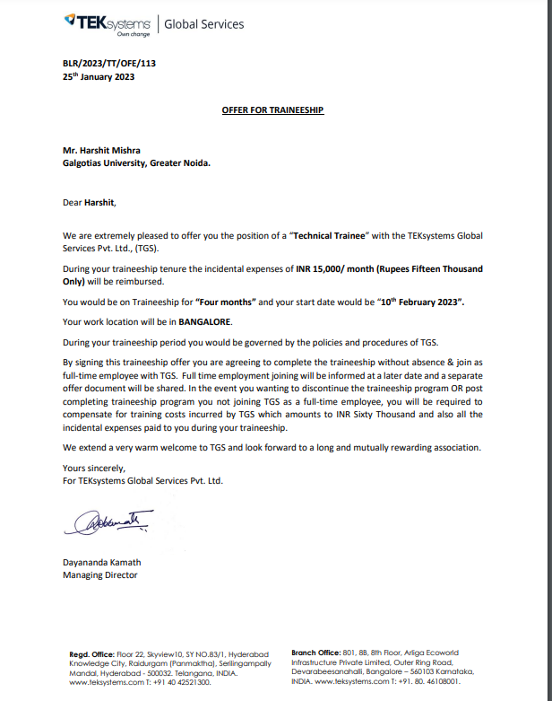
Offer Letter

Slide 7
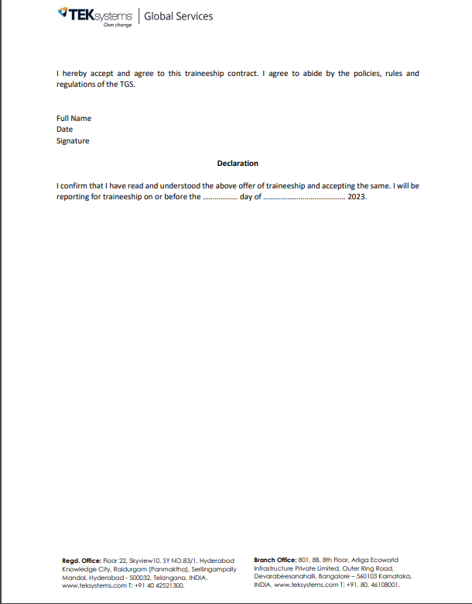

Slide 8
THANK YOU

